Slide 1
Welcome to Music Online

Slide 2
INTRODUCTION
“Online Music Store” refers to systems that will enable the client to mobilize its business through selling and buying the different music related items in the website.
It will enable a customer to have access to online shopping that is the site should be dynamic and more customer centric business procedure thereby maximizing the profit of the organization

Slide 3
EXISTING SYSTEM
➢Customer has to manually visit the music shop and need to purchase the music item they needed.
➢The wastage of time for searching a particular venue and a particular shop.
➢The wastage of money as transportation for searching a particular shop.

Slide 4
PROPOSED SYSTEM
1.The proposed system uses GUI framework. This system is highly user friendly because the entire programs are menu driven so that the new comer can use the software efficiently.
2.The main intention of the proposed and designed system is to automate the shopping channel between the company and the clients, and easy the user work. Through this an end user can easily purchase the needed thing from his home, or anywhere by just clicking the mouse. And it increases the mentality of shopping.

Slide 5
ADVANTAGES OF PROPOSED SYSTEM
➢Automate the communication between the users and the company.
➢ Save the time of customer.
➢It provides 24 hours of facility.
➢Everyone can access the system those who are living in any place.
➢ Easy for shopping.
➢ Increase the shopping interest.
➢Decrease the time wastage.

Slide 6
MODULES
• Visitor module
• User module
• Administration module

Slide 7
VISITOR MODULE
✓ New user can visit the home page of the
online music site
✓ Search for a particular music item
✓ Cast his vote for a particular song
✓ For purchasing items, first the visitor has to
click the register option in the client login area.
✓ The user must fill the registration form. The
data are stored in to the database.
✓ After that the visitor becomes a user and then
he can enter into the shopping cart.
✓ View the Help page

Slide 8
USER MODULE
✓First he/she has to login into the user interface.
✓For the client to log in to the system it has to provide its username and password for authorization purpose.
✓ If the username and the password match with the entry in the database then the client enters the client shopping area. The client shopping area has three options to be utilized.
✓The first option gives the client to search the list of music CD’s/Cassettes offered by the shop where the client can select the required one.
✓The second option gives the client to add items to shopping cart.
✓The third option gives the client to give feedback.
✓The forth option gives the client to logout from the site.

Slide 9
Administrator Module
✓ Delete a particular user from the database
✓ Add particular item to the inventory list
✓Modify the details regarding a particular
music item
✓View the report, which includes sales reports for a specified day, previous week, and previous month.

Slide 10
elp page
Overall Design of Emusic World.com
www.emusicworld.com
HomePage
Login to site
Administrator
Login page
Search items
Select items to buy
Delete a user
View new items
Add items to inventory
Add items to cart
Registration page for New users
Modify the items
View cart
Logon page
View sales report
Feed Back
View h
View user message

Slide 11
Get user information from Login-Page
Check authentication user or not
If ok
Logout
Shopping Cart
Show Welcome Page
Buy
Song details,
CD-details, Price etc
Buying List
Verification of credit/debit card information’s
Songs selection
Adding songs to cart
Feedback

Slide 12
Context Level Diagram
Music Online
User
User
communicates
Services

Slide 13
First Level Diagram
visitor
Valid
Login
Verification
User
valid
Invalid
user
Valid
administration

Slide 14
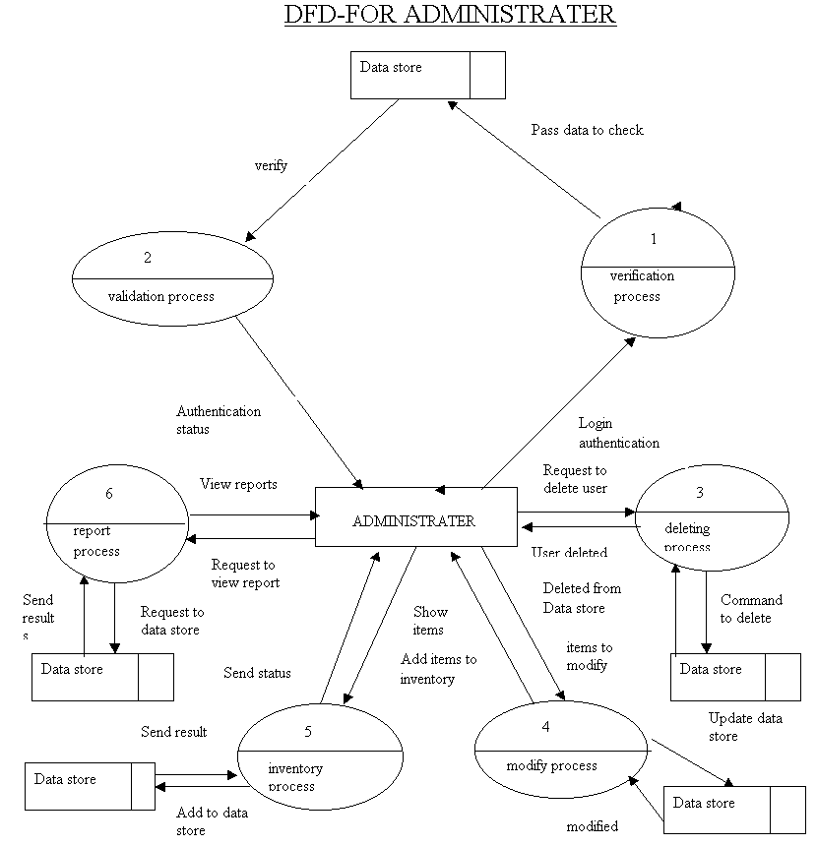

Slide 15
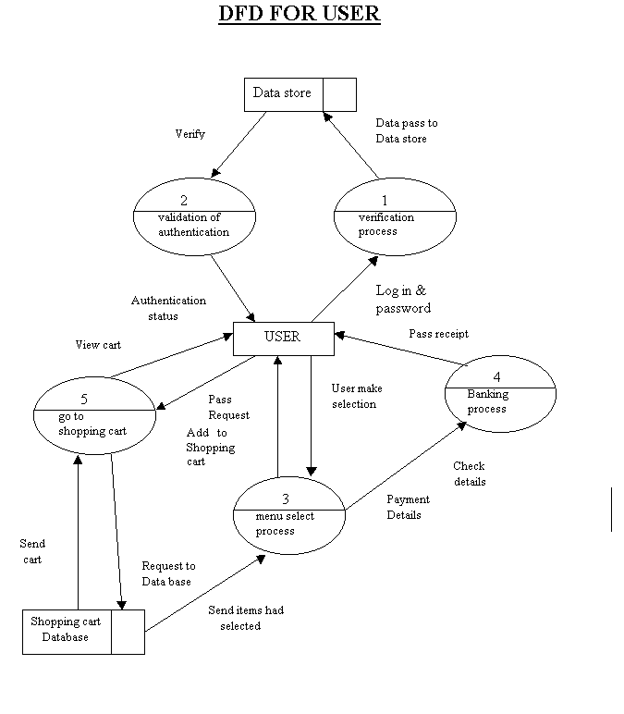

Slide 16
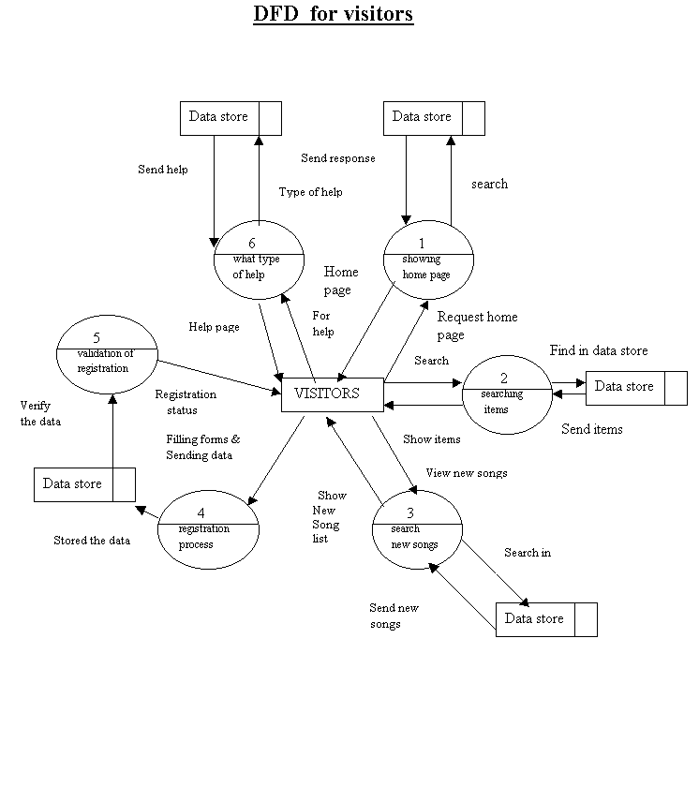

Slide 17
The User Info Table
Column Name
Data Type
Size
Request ID
Int
4
User name
Var char
20
First name
Var char
20
Middle name
Var char
20
Last name
Var char
20
Date of Birth
Date time
10
E-mail
Var char
25
Address_line1
Var char
50
Address_line2
Var char
50
City
Var char
25
State
Var char
25
Credit card
Char
16
Credit card Type
Char
25

Slide 18
The User Info Table
Column Name
Data Type
Size
Request ID
Int
4
User name
Var char
20
First name
Var char
20
Middle name
Var char
20
Last name
Var char
20
Date of Birth
Date time
10
E-mail
Var char
25
Address_line1
Var char
50
Address_line2
Var char
50
City
Var char
25
State
Var char
25
Credit card
Char
16
Credit card Type
Char
25

Slide 19
The Item Master Table
Column name
Data Type
Size
Item Code
Char
8
Title
Var char
50
Rate
Float
50
Item Desc
Var char
50
Singer
Var char
50
Qty on hand
Int
50
Type
Var char
50
Release Date
Date time
8

Slide 20
The Login Info Table
Column Name
Data Type
Size
User name
Var char
20
Password
Var char
20
Secret Question
Var char
20
Secret Answer
Var char
20
Role
Char
10

Slide 21
The Reply Info Table
Column Name
Data Type
Size
Reply date
Date time
8
Reply msg
Var char
50
Reply user name
Var char
20

Slide 22
The Sales Master Table
Column Name
Data Type
Size
Sale Date
Date time
8
Item Code
Char
8
Sale qty
Int
4
Rate
Money
8
User name
Var char
20

Slide 23
The Vote Info Table
Column Name
Data Type
Size
Item Code
Char
8
Number votes
Int
4

